Slide 1
DevOps & Containers

Slide 2
AGENDA
Understanding DevOps
DevOps Tooling (e.g. SonarQube)
Introduction to Containers
Container Orchestration
DevOps and Containers in Practice
Deployment Automation

Slide 3

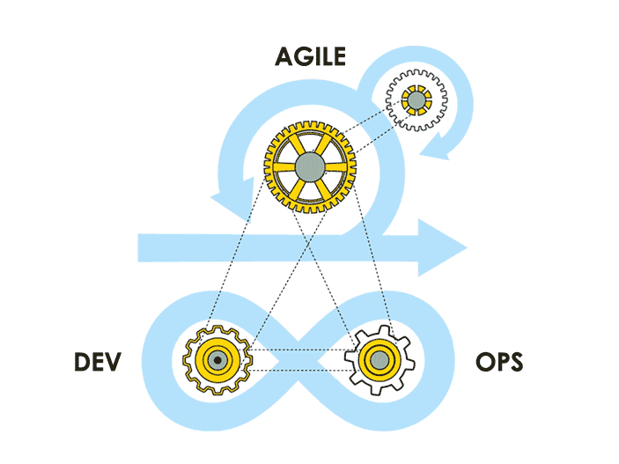
Do you need Change?
Are you troubled by the strange ways your organization delivers software ?
Do you experience feelings of dread when preparing for a long painful application release?
Have you or your co-workers experienced buggy, unstable services after deployment?
Does it take days, weeks, or even months to build and deploy an application?
If your answer is YES
You need DevOps

Slide 4


The DevOps Story
DEV
OPS
Traditional Development and Operations

Slide 5
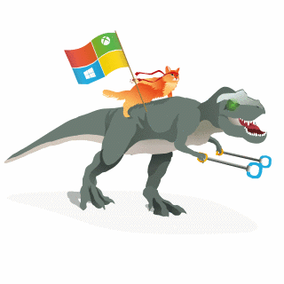
Happy DevOps
DEV
OPS
Production
Inspired by Microsoft

Slide 6

What is DevOps?
It’s DevOps!
“DevOps is treating your infrastructure as code”
“DevOps is development and operations collaboration”
It’s DevOps!
“DevOps is using automation”
It’s DevOps!
“DevOps is feature switches”
It’s DevOps!
“DevOps is small deployments”

Slide 7
Why Is DevOps Important Now?
Enterprises have young, nimble startup competitors
Agile software development is increasing
More organizations are migrating to the cloud
Consumers have "app" mindsets and expectations
There is more data available to the business
Time to market must decrease
Is DevOps realistic for Enterprise IT?
Yes
While enterprise IT faces legacy challenges, DevOps practices are universal and adaptable to different environments.

Slide 8
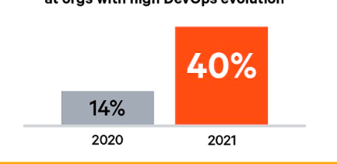
DevOps Benefits
Strong IT Performance is a competitive advantage
Deploy code 30x faster
and with 200x shorter lead time as compared to your lower-performing peers
Firms with high-performing IT teams were 2x as likely to exceed their profitability, market share, and productivity goals
DevOps practices improve IT performance
Have 60x fewer failures
and recover from failure 168x faster as compared to lower-performing peers
Source: www.devopsdigest.com

Slide 9
Benefits of DevOps ?
Empowering teams
Lowered cycle time
shortens lead times for changes
time to market goes down
lower MTTR
Better security with better quality
Rhythm of practice (limits your work in progress)
More time to be productive

Slide 10
DevOps Tooling (SonarQube)

Slide 11
What SonarQube is / does?
Free & open source Code Quality Platform
Provides moment-in-time quality snapshots
Gives trends of lagging and leading indicators
Tracks developers' seven deadly sins (seven axes of quality)

Slide 12
How does it work?
Analyzes source code and byte code
Computes hundreds of metrics
Associates metrics with analysis snapshots
Shows the results in dashboards and widgets accessible by any browser

Slide 13
SonarQube for everything
Initially developed only for Java projects
Today supports over twenty languages
Commercial Release: C, C++, Obj-C, Swift, ABAP, T-SQL, PL/SQL
Open Source Release: Java (including Android), C#, Python, Swift, PHP, Kotlin, Ruby, Scala, Web (HTML, CSS, žJavaScript, XML) ABAP, Flex, Objective-C, PL/I, VB.NET,

Slide 14
Managing code quality
Dashboards
Historical data
Differential views
Compare service
Code reviews
Action plans

Slide 15
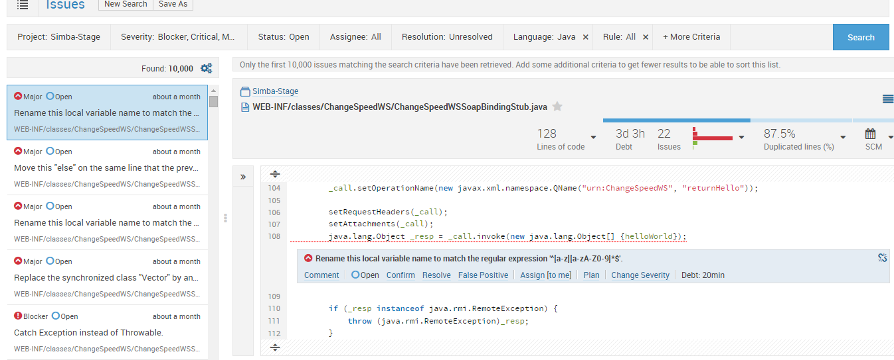
Sonar – Project Drill Down

Slide 16

Container Introduction
Notes:
Mandatory
ACTION: Adjust title to fit your course.

Slide 17
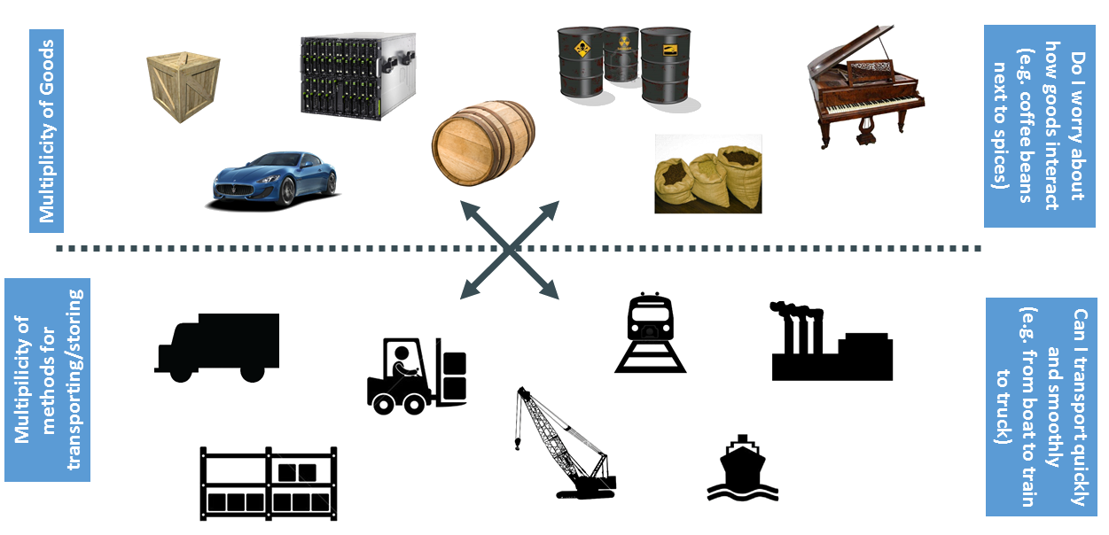
Shipping Industry
Notes:
Pre 1960
Problem of Merchant
Shall I ship coffee beans with spices
Should I be bothered that how they are handle while shipping from one place to another, who are there companion will that impact the quality
Is the staff capable of handling the goods
Is the mode of transport being used is good for my products
Problem of Tansporter
What should I use as transport, boat, ship for a particular kind of product
I need to have staff for each type of good to know how to handle it

Slide 18
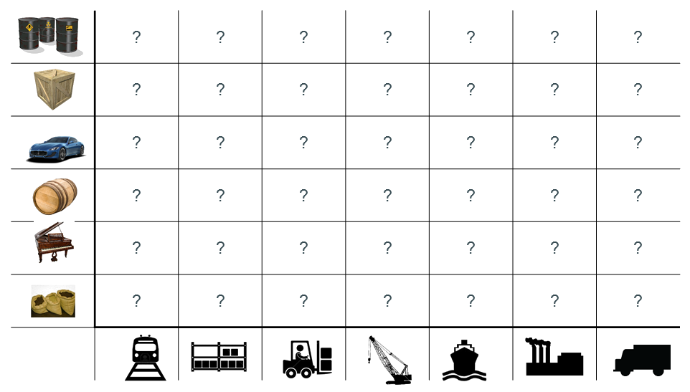
Matrix from Hell?

Slide 19
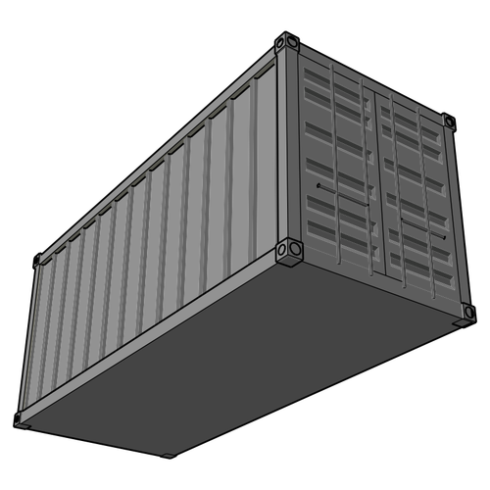
Tada!!

Slide 20
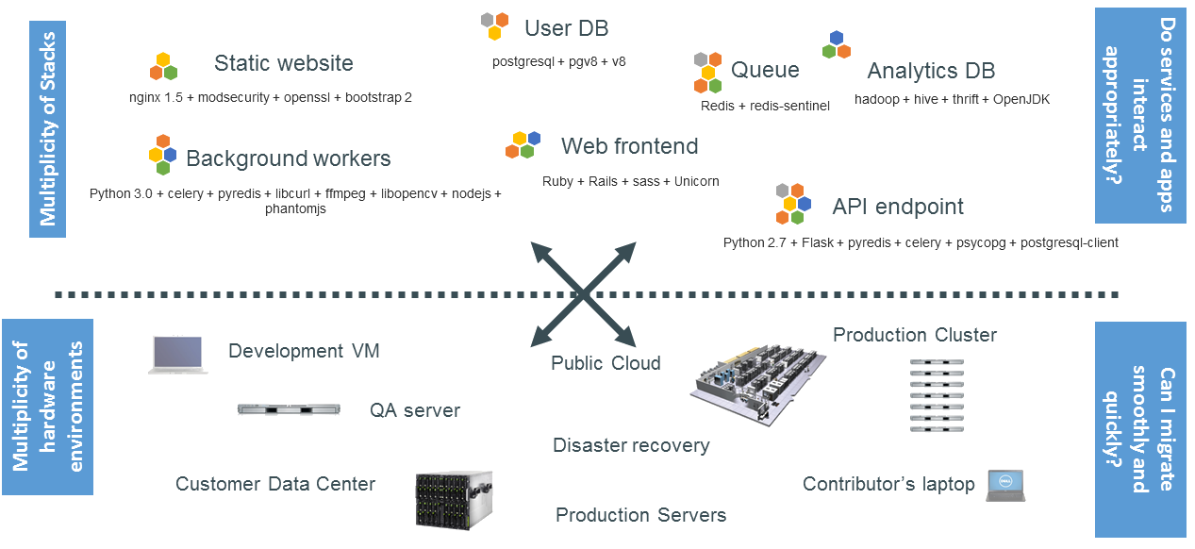
Challenge
Notes:
Is it challenging to host current generation application
Multiplicity of stacks
Multiplicity of H/w env
My own laptop
My fellow teammate laptop, who would be having a different OS & softwares
Dev env
QA env
PT env
Prod
SAAS
PAAS

Slide 21
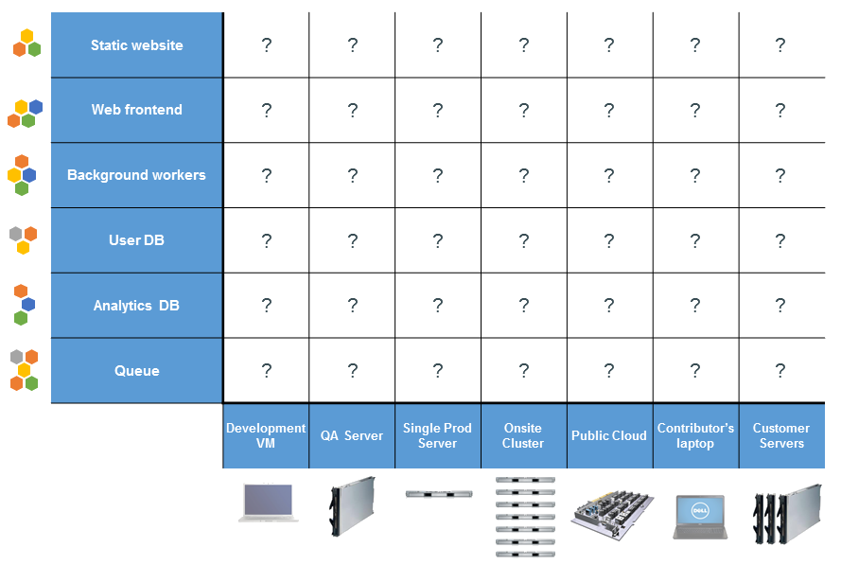
Matrix from Hell
Notes:
You have to make sure that all the cell’s should be functional i.e the application if it works on local developer machine should work without any issue on fellow developer and should work without any issues on Production server.
One of the standard thing that usually there is a differnce in Server operating system and the operating system of local developer

Slide 22
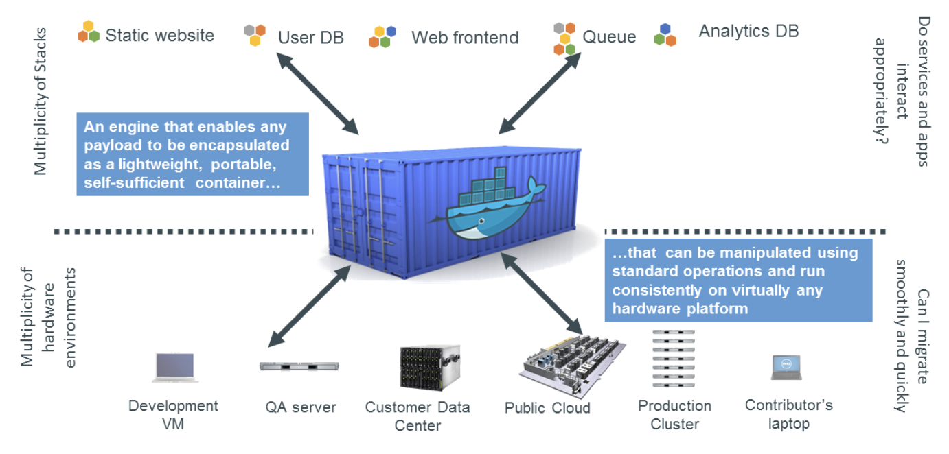
Docker is a shipping container system for code

Slide 23
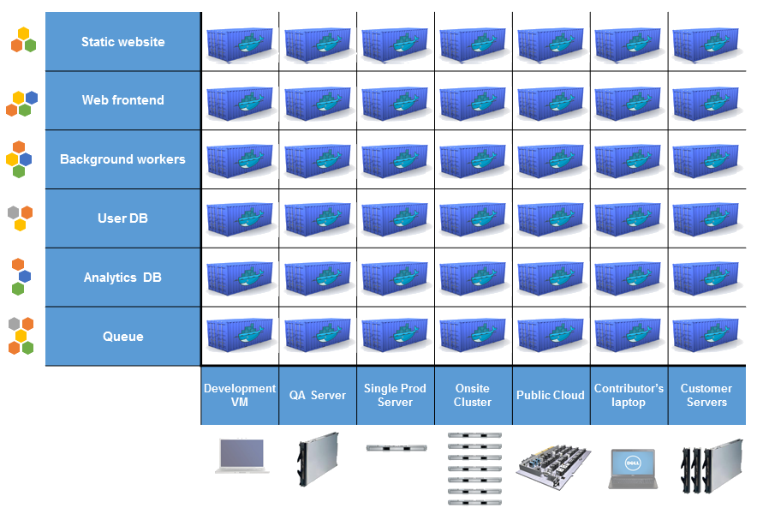
Another TADA!

Slide 24
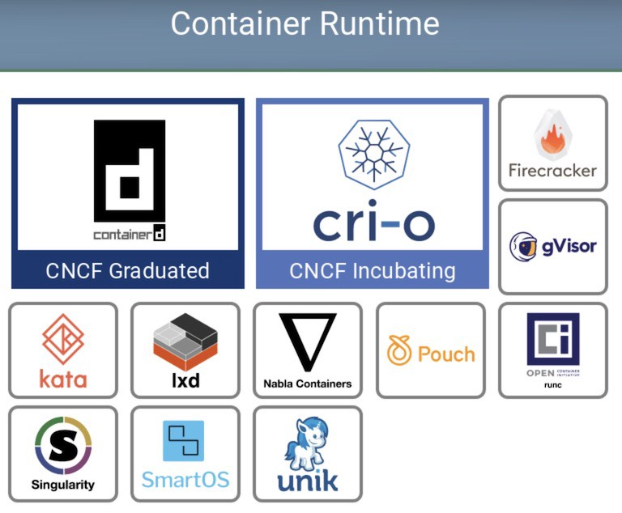
Solution
CONTAINERS
MYSQL
MYSQL
MYSQL
APP
APP
APP
BINS/LIBS
BINS/LIBS
CONTAINER ENGINE
HOST OPERATING SYSTEM
SERVER
Notes:
Containers are portable, entirely self contained machines that run on a host OS, whether virtual or bare metal.
Containers run the same everywhere and can be run on different flavors of OS in the same way
They can be clustered together on machines of different sizes.

Slide 25
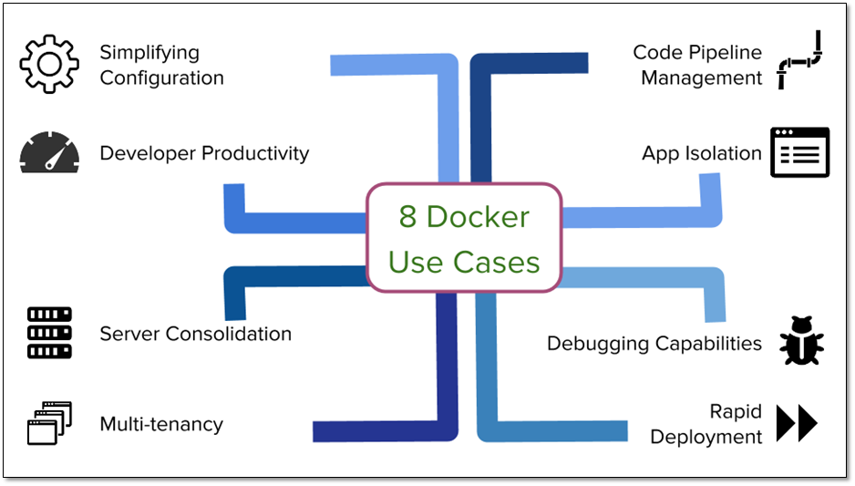
Container Advantages
Container Use Cases
Notes:
Simplifying configuration: Straightaway Jenkins can be run by providing parameters
Developer productivity: Backend Frontend team
Server Consolidation: Ideal practice before container was 1 server 1 app because they interfere with each other, now with containers you can have multiple app’s without interfering or impacting each other.
Multi Tenancy: Drone.io, CircleCI
Code Pipeline: instead of talking in terms application artifacts we will ship complete runtime(app, infra)
App isolation: Mongo(eat up memory: separate system)
Debugging capabilities: Closely related to microservices concepts
Rapid Deployment: build once run anywhere philosophy, environmental issues, POC’s

Slide 26


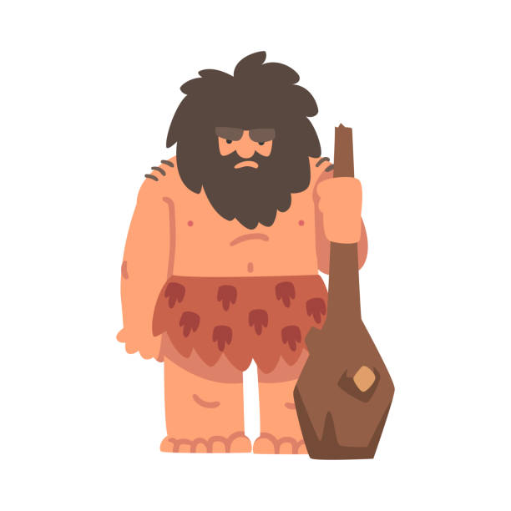

Base Architecture Difference
Virtual Machine
Docker
APP1
APP2
APP3
APP1
APP2
APP3
LIBRARIES
LIBRARIES
LIBRARIES
LIBRARIES
LIBRARIES
LIBRARIES
GUEST OS 1
GUEST OS 2
GUEST OS 3
CONTAINER ENGINE
HYPERVISOR
HOST OPERATING SYSTEM
HOST OPERATING SYSTEM
HARDWARE
HARDWARE

Slide 27
What Is Docker ?
Docker containers wrap up a piece of software in a complete filesystem that contains everything it needs to run:
code
runtime
system tools
system libraries
It will always run the same, regardless of the environment it is running in.
It is an open platform to build, ship and run distributed applications.
APP1
APP2
APP3
LIBRARIES
LIBRARIES
LIBRARIES
CONTAINER ENGINE
HOST OPERATING SYSTEM
HARDWARE

Slide 28

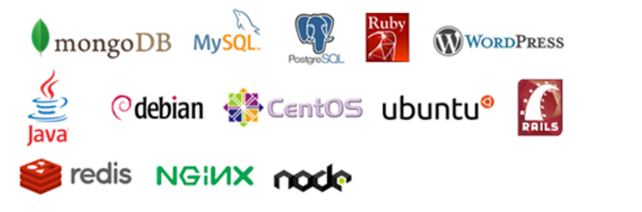
Docker | Images
Key concepts:
Images are inherited from base images and can be many levels deep
Image is the definition of what a container is created from
Images are immutable. If you make changes, a new image must be built.
Images are made of layers
When pushing/pulling an image to a repository (more to come), only the changed layers are pushed to save bandwidth.
I’m a web server image made up of:
Linux OS: Ubuntu | Layer 1 | 800 MB
Security patches & fixes | Layer 2 | 3 MB
Nginx server | Layer 3 | 100 MB
Nginx plugins | Layer 4 | 50 MB
Custom website | Layer 5 | 15 MB

Slide 29
Docker | Images Inheritance
All images are based on other images as their parent.
You must choose a parent, or FROM image.
Scratch is the base empty image supplied by Docker.
Base images include all settings and files, like what command runs to at startup, etc.

Slide 30
Docker | Images name & tags
Docker images are given a unique ID by default, but you can make them easier to use with names and tags.
The name is the unique identifier for a class of images
Every image gets a tag which is like the version of that image name.
Image and tag are separated by a colon.
For example, myimagename:mytag
There is a reserved tag name of latest
If you omit the tag, then latest is assumed
For example, docker pull nginx is equivalent to docker pull nginx:latest from Docker Hub

Slide 31
Docker | Containers
Key concepts:
All containers have a single ENTRYPOINT, or the process that starts when the container starts.
The lifecycle of the container is tied to this process.
We can run additional processes against a container after it is started, but they do not affect the container lifecycle.
I’m a web server container:
Ports
Environment Variables
Volumes
I’m a web server container:
Ports
Environment Variables
Volumes
I’m a web server image made up of:
Linux OS: Ubuntu | Layer 1 | 800 MB
Security patches & fixes | Layer 2 | 3 MB
Nginx server | Layer 3 | 100 MB
Nginx plugins | Layer 4 | 50 MB
Custom website | Layer 5 | 15 MB

Slide 32
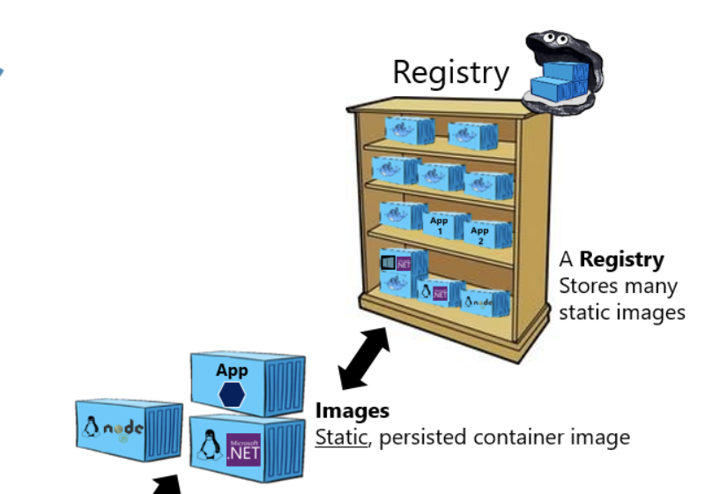
Docker Registries
Key concepts:
By default, all images are pushed to and pulled from Docker Hub
To push to a different registry, just include the URL to it in your image name. This tells Docker where to push or pull from.
For example, mycompanyregistry.com/mynginx:1.0
If the registry is secured, then use a docker login command to gain access

Slide 33

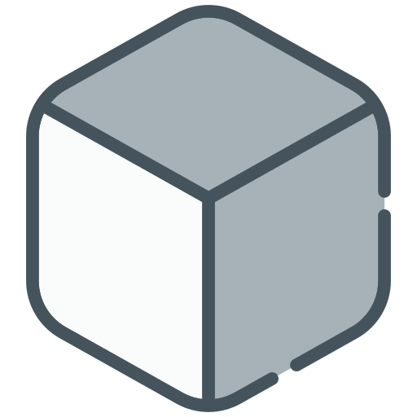
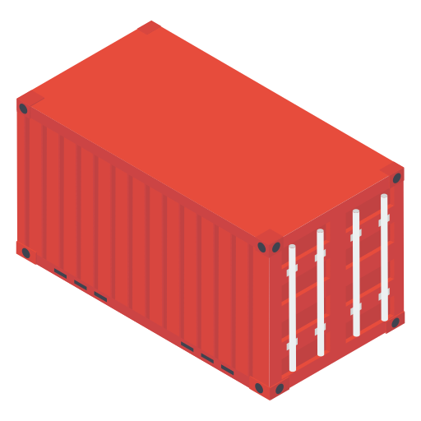
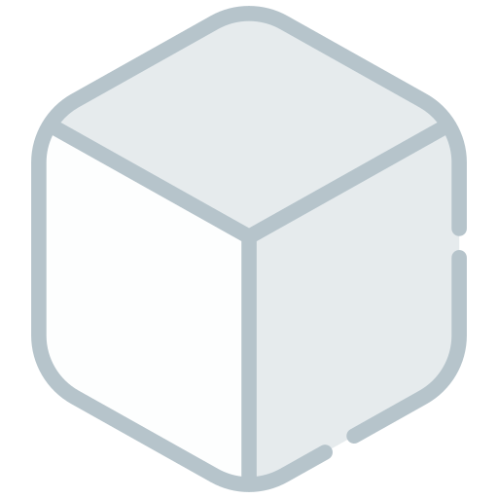
Docker Architecture
CLIENT
SERVER
REGISTRY
docker pull
Docker Daemon
docker run
Image 2
Container 1
Image 1
Image 2

Slide 34
Docker CLI
Docker command line interface gives us everything we need to build, interact, inspect, and run containers and images. Many of the commands mimic Linux commands. All commands start with docker.
Reference: https://docs.docker.com/edge/engine/reference/commandline/docker/
ps
list running containers (include –a to see stopped containers).
rm / rmi
remove container.
inspect
inspect running container.
start/ stop/ restart
start/stop/restart a container.
cp
copy files to/from a container to local filesystem.

Slide 35
Docker CLI
run – run a container from an image
-d – detached
-p – port mapping
-it – interactive (gets you a command line in the container)
--name – assign a name
-e – environment variable
-v – volume mapping
build
build an image from Dockerfile
images
show images
rmi
remove image
push/ pull
push/pull the image to a repo
tag
tag an image

Slide 36
Dockerfile
Overview
Instructions
There are two ways to create an image in Docker:
A Dockerfile is an example of infrastructure as code.
It is the preferred way to build images.
A Dockerfile is a text file that has a series of instructions on how to build your image.
Every line in a Dockerfile builds a new layer in your image.
Commands are run from top to bottom.
FROM – which image this inherits from
MAINTAINER – An owner (no functionality)
WORKDIR – Change to a directory until changed again. Works like cd
USER – Change to a user
RUN – Run a Linux command in a new layer. The command is dependent on which shell is in the image.
EXPOSE – Tells what ports this container will listen on. Does not actually publish a port, but is rather like documentation.
ADD – copy files into the container
COPY – copy files into the container. Same as ADD.
ENTRYPOINT – The command to be run when container is started. This is inherited from a base image.
CMD – provides defaults to be run after the ENTRYPOINT. Also inherited from the base image.
Notes:
There are two ways to create an image in Docker:
With a Dockerfile
From an existing container
A Dockerfile is an example of infrastructure as code. It represents a repeatable build of your Docker image. It can be stored in your code repo, versioned, and reviewed.
Dockerfile is the preferred way to build images. You should have a good reason to do it the other way.
A Dockerfile is a text file that has a series of instructions on how to build your image.
Every line in a Dockerfile builds a new layer in your image.
Commands are run from top to bottom, and each is independent from others and run from the directory where the Dockerfile is located.

Slide 37
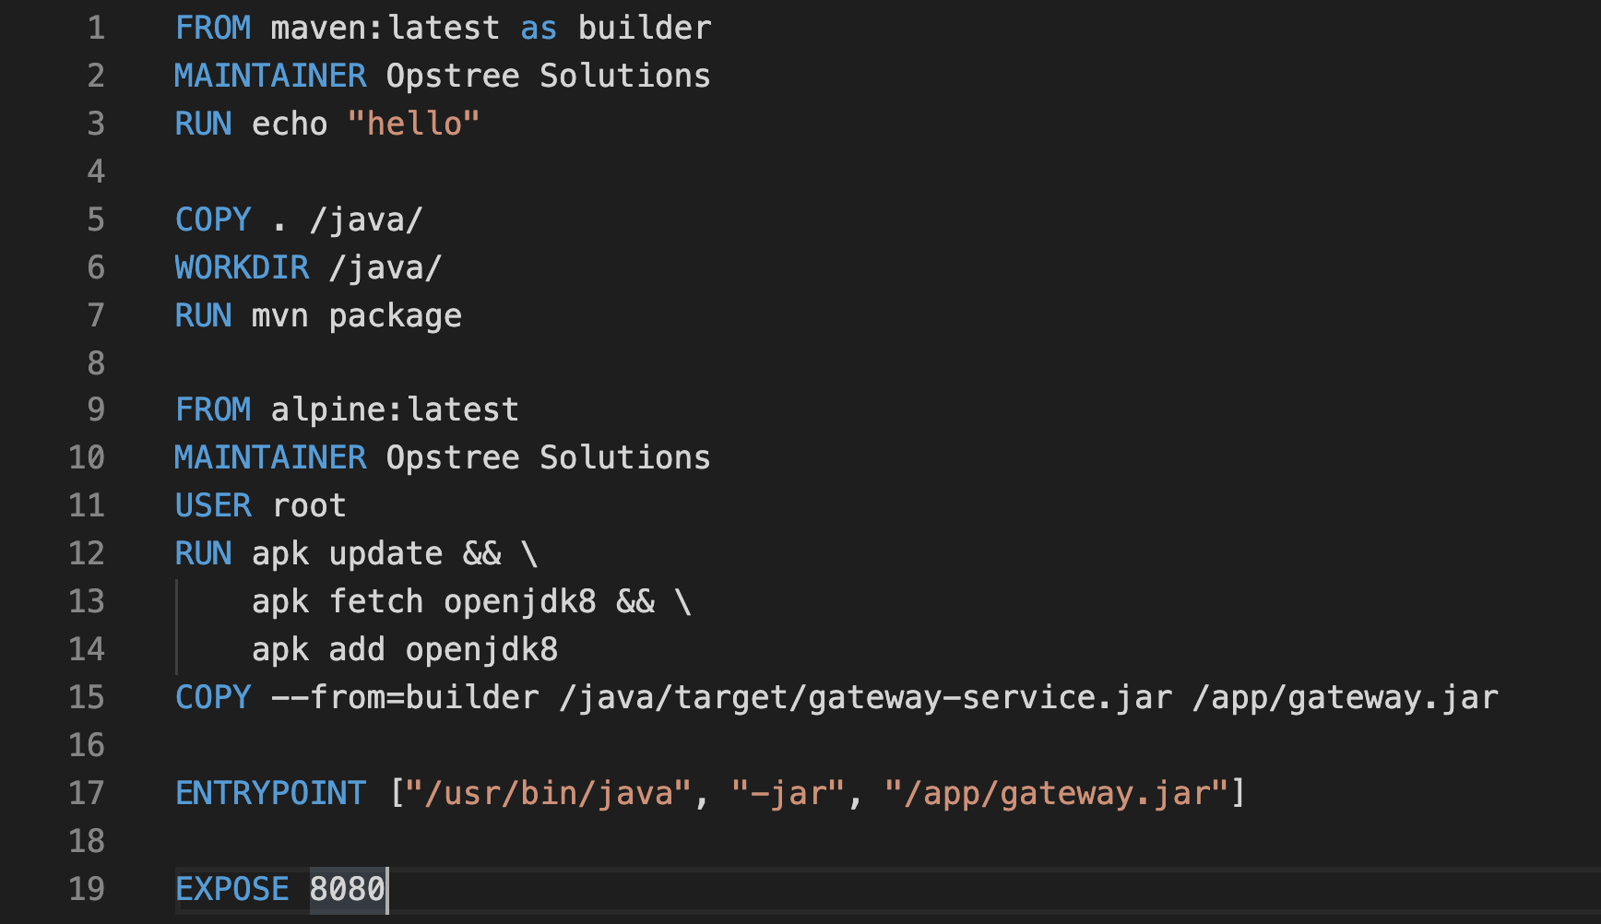
Dockerfile | Walkthrough

Slide 38
Dockerfile | Image building
Building an image is a simple CLI command:
docker build –t <name>:<tag> <location of Dockerfile>
docker build –t myimage:v1 .
This builds from the Dockerfile and tags it in one operation. The tag is optional but typically used. You would need to do a separate command to tag from the image ID if you omit it.

Slide 39
Container Orchestration
Notes:
Mandatory
ACTION: Adjust title to fit your course.

Slide 40
Problems with Containers
Not easily Scalable
Containers Isolate the application from the host - for both Linux and Docker containers.
FASTER, RELIABLE, EFFICIENT, LIGHTWEIGHT, AND SCALABLE
Notes:
Is it challenging to host a LAMP based application

Slide 41
Problems with Containers
Not easily Scalable
1
Containers could communicate with each other
2
Containers had to be deployed appropriately
3
Containers had to be managed carefully
4
Auto scaling was not possible
5
Distributing traffic was still challenging
Notes:
Is it challenging to host a LAMP based application

Slide 42
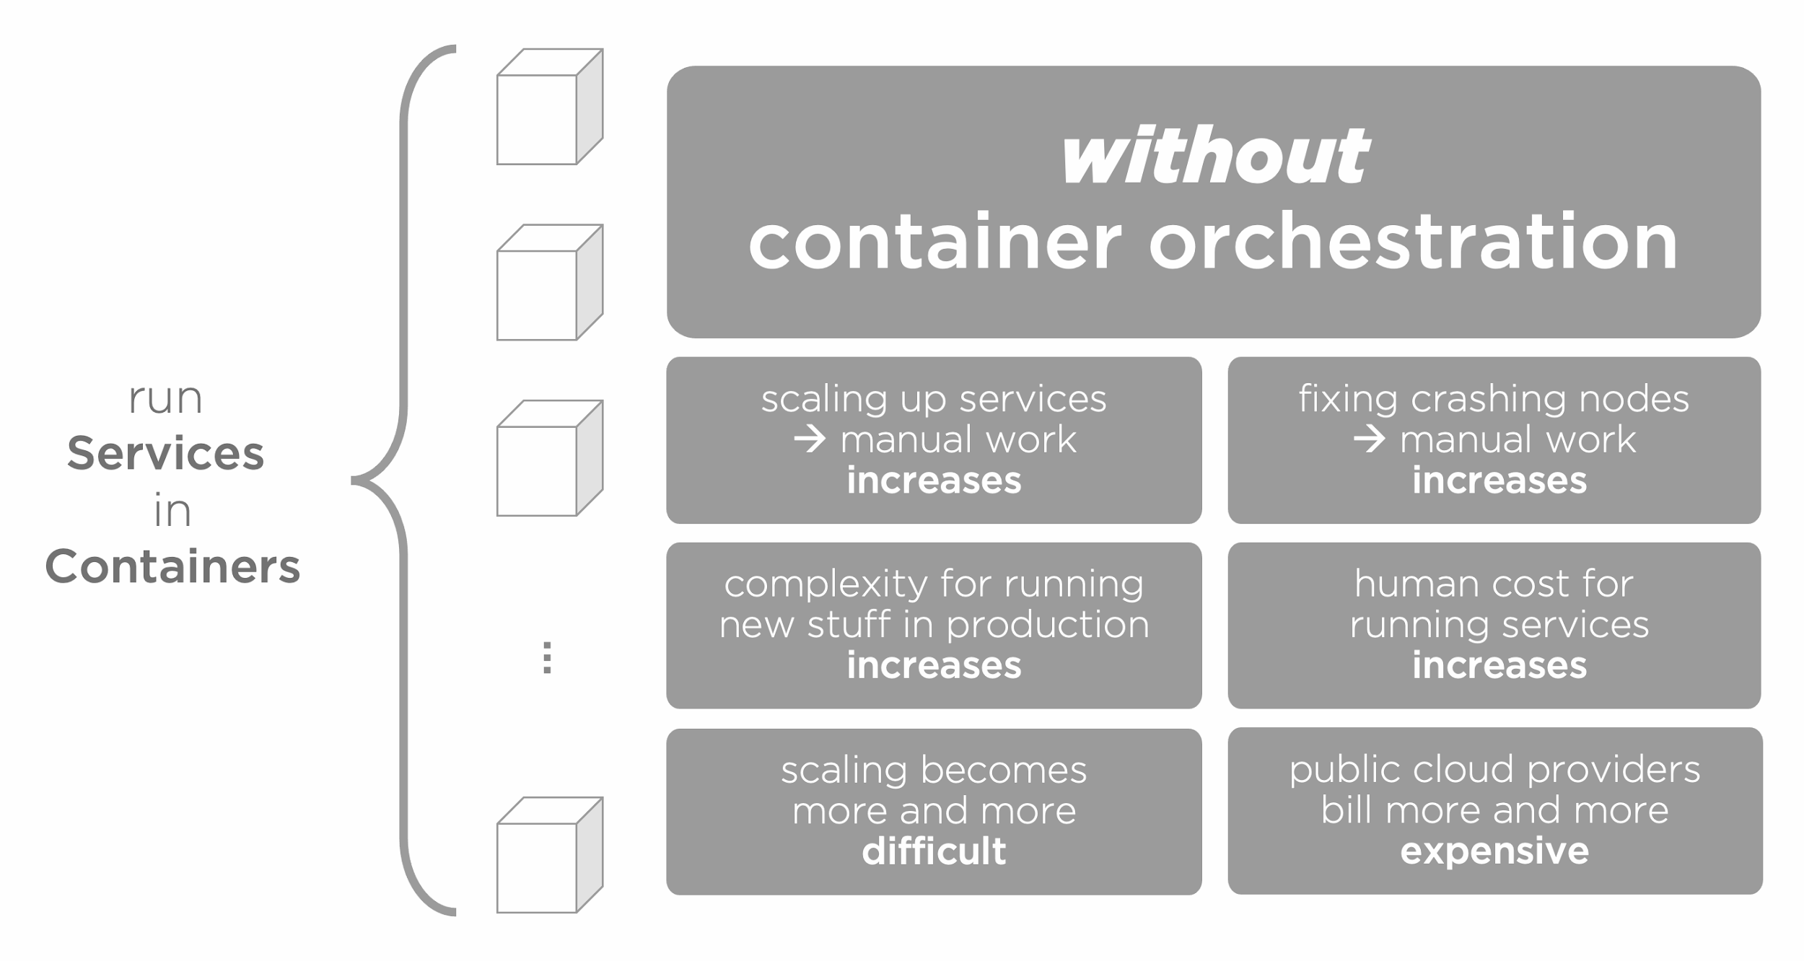
Containers without Orchestration
Notes:
Is it challenging to host a LAMP based application

Slide 43
Why do we need Containers Orchestration?
Because,
Containers are lightweight and ephemeral by nature, but running hundreds of them in production can quickly become a massive effort.
Typically each microservice runs in its own container, so when hundreds of microservices are needed to build and operate a large-scale containerized application, it translates into operating hundreds, sometimes even thousands, of containers.
No amount of manual management can reduce or handle this level of complexity.
Automated Container Orchestration can make operational complexity manageable for both development and operations (DevOps) teams by providing a declarative style of automating most of the work.
Notes:
Is it challenging to host a LAMP based application

Slide 44
What is Containers Orchestration?
Container orchestration is the automation of much of the operational effort required to run containerized workloads and services.
It is a wide range of tasks a team manages during a container’s lifecycle, including:
provisioning,
deployment,
scaling (up and down),
networking,
load balancing and more.
Notes:
Is it challenging to host a LAMP based application

Slide 45
Benefits of Containers Orchestration
Improved fault-tolerance
Better on-demand scalability
Optimal resource usage
Auto-discovery for discovering and communicating with other containers
Easier accessibility from the outside world
Seamless updates/rollbacks without any downtime
Notes:
Is it challenging to host a LAMP based application

Slide 46
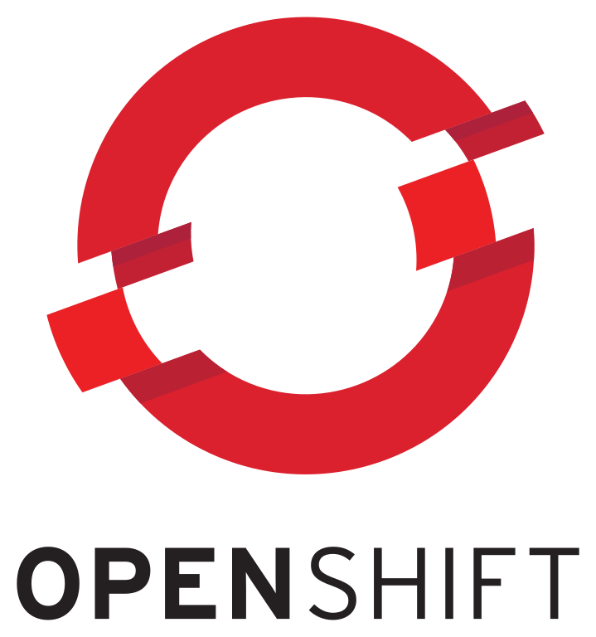
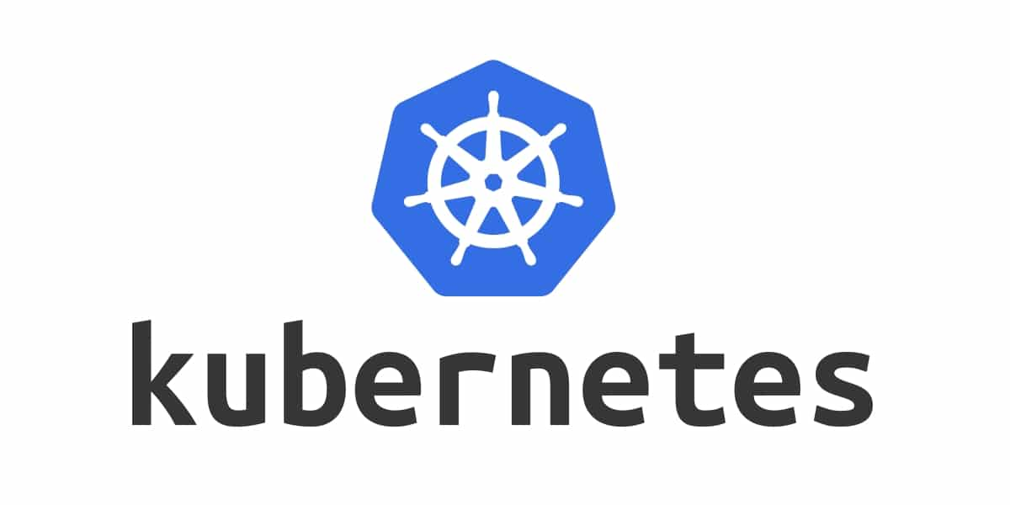
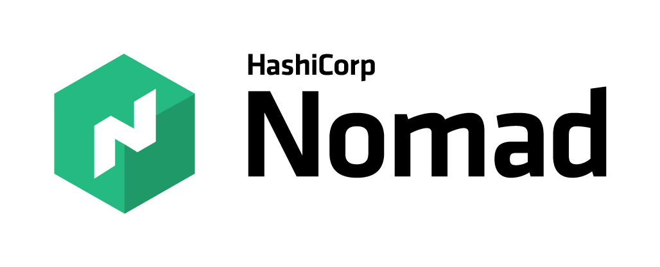
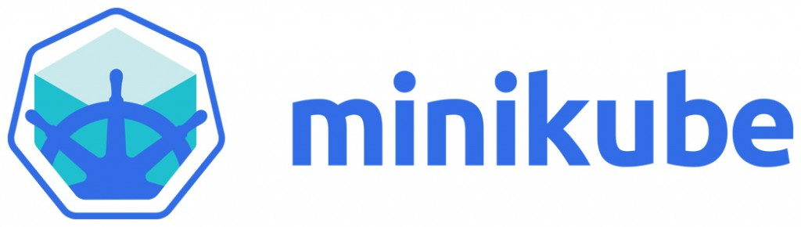

Container Orchestration Tools
Notes:
Is it challenging to host a LAMP based application

Slide 47
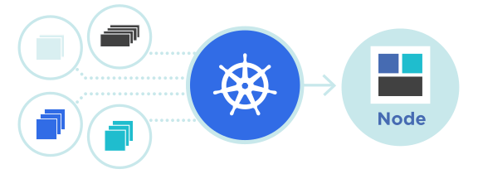
Kubernetes
Kubernetes is an open-source container management tool that automates container deployment, container (de)scaling and container load balancing
More about Kubernetes
Developed by Google, written in Golang, a large community base.
Works with all cloud vendors - public or private (including on-prem clouds), and hybrid clouds.
Can group multiple containers into one logical unit for easy management and deployment.
Notes:
Is it challenging to host a LAMP based application

Slide 48
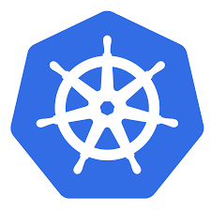
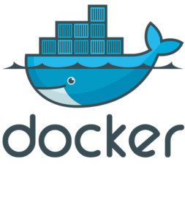

Kubernetes
Node
Node
Node
Cluster
Notes:
Is it challenging to host a LAMP based application

Slide 49
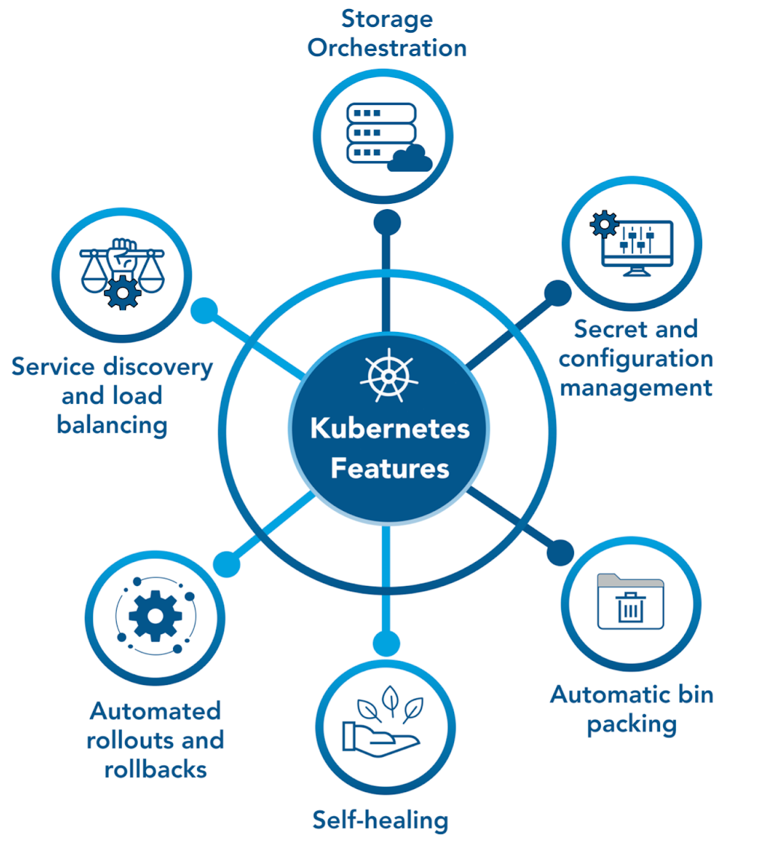
Kubernetes Features
Notes:
Is it challenging to host a LAMP based application

Slide 50
Busting Kubernetes Myths
X
Kubernetes is not:
the same as Docker;
for containerizing apps; and
to be used for apps with simple architecture.
Kubernetes is actually:
a container orchestration platform;
a solution for scaling up containers;
backed by huge community; so
is quite robust and reliable.
√
Notes:
Is it challenging to host a LAMP based application

Slide 51
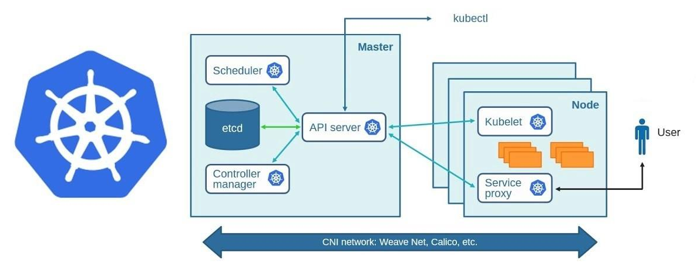
Kubernetes Components
Notes:
Is it challenging to host a LAMP based application

Slide 52
DevOps & Container in Practice
Notes:
Mandatory
ACTION: Adjust title to fit your course.

Slide 53
Integrating DevOps practices with Containerization
DevOps - promote collaboration, automation, and continuous delivery; speed up and enhance software development and deployment reliability.
Container - a portable, lightweight application environment to ensure consistency and eliminate compatibility issues.
They are essential, inter-related elements of modern software development and deployment lifecycle:
Streamline SDLC by integrating DevOps wit Containerization – from building & testing to deploying & scaling apps.
Deliver software applications more rapidly, reliably, and at scale.
Encourage efficiency, acceleration, and scalability within teams.

Slide 54
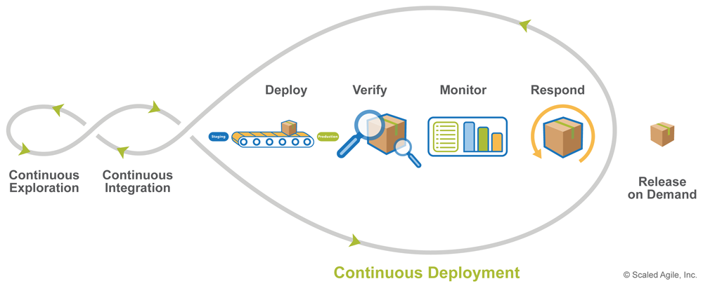
CI/CD
Source: https://puppetlabs.com/

Slide 55
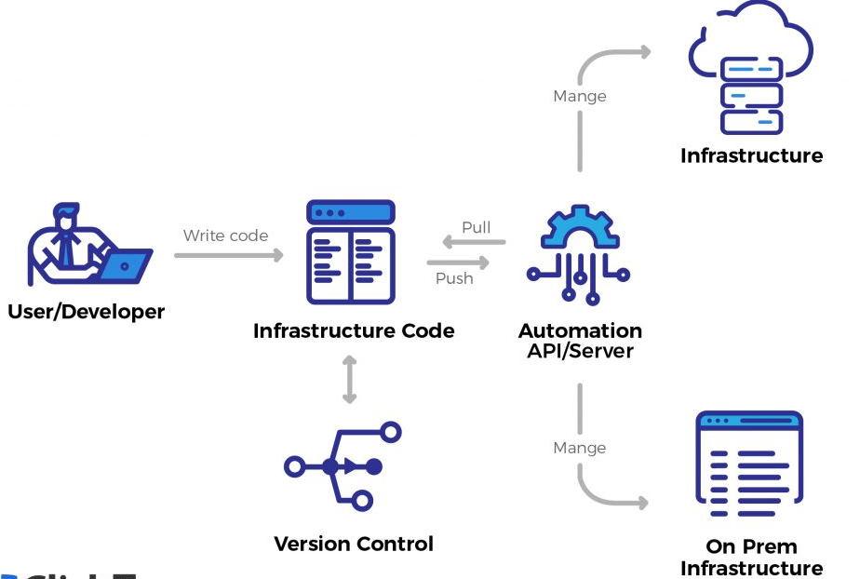
What is Infrastructure as Code (IaC) ?
IaC manages infrastructure using a descriptive model
Infrastructure includes networks, virtual machines, load balancers, to name a few
An IaC model produces the same environment every time it is applied

Slide 56
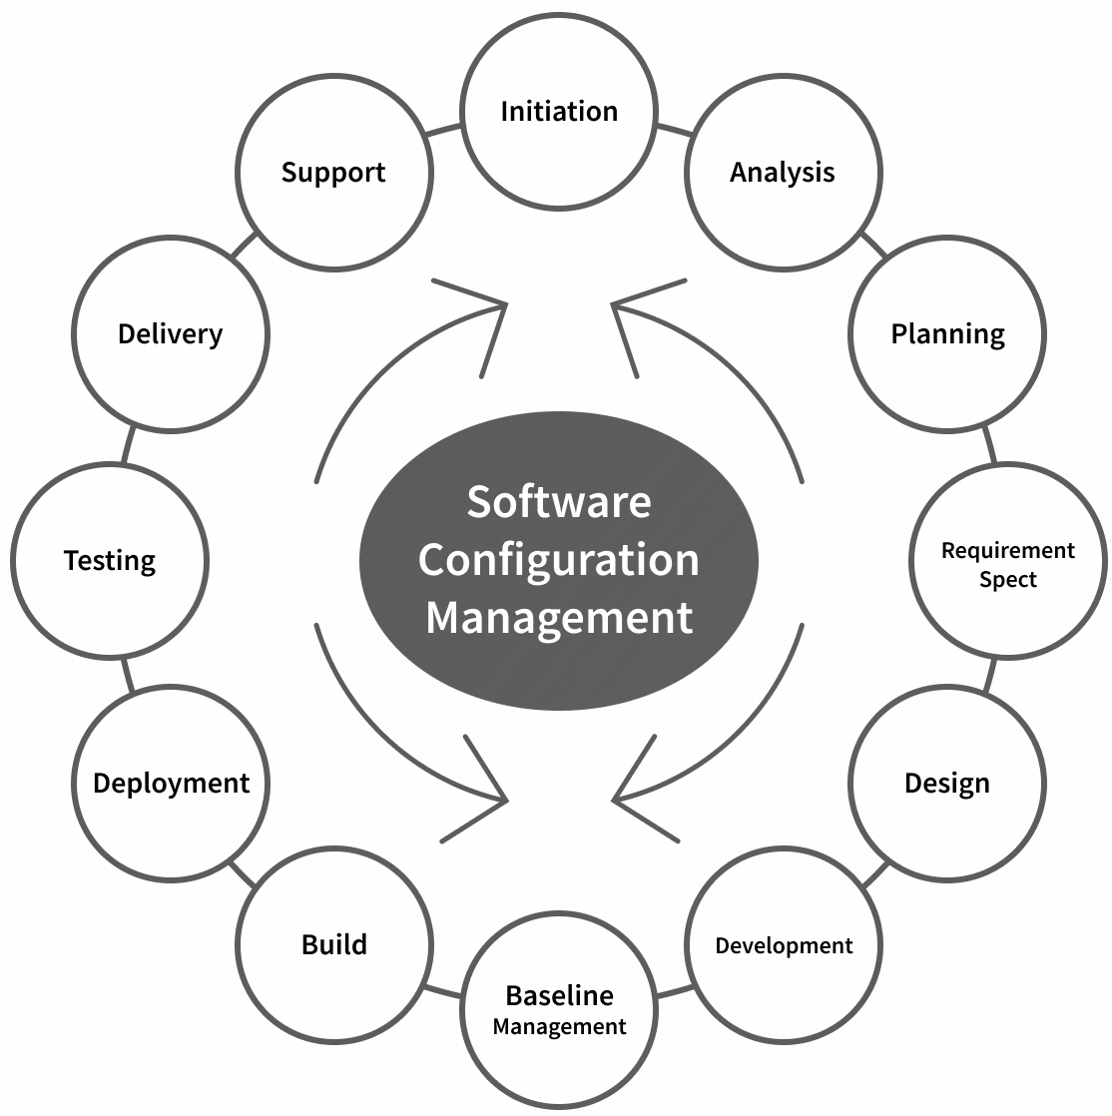
What is Configuration Management?
Configuration Management (CM) maintains the consistency of an application’s performance, as well as its functional and physical inputs along with requirements, overall design, and operations throughout the lifespan of the product.

Slide 57
Infrastructure-as-Code vs. Configuration Management
Infrastructure as Code | Configuration Management
Practice of managing and provisioning IT infrastructure through code | Practice of automating the configuration and management of software applications, operating systems, and servers
Allows teams to manage infrastructure in a repeatable, scalable, and automated manner | Allow teams automate the installation and configuration of software packages, enforce security policies, and manage system settings
Focuses on the infrastructure layer | Focuses on the application layer

Slide 58
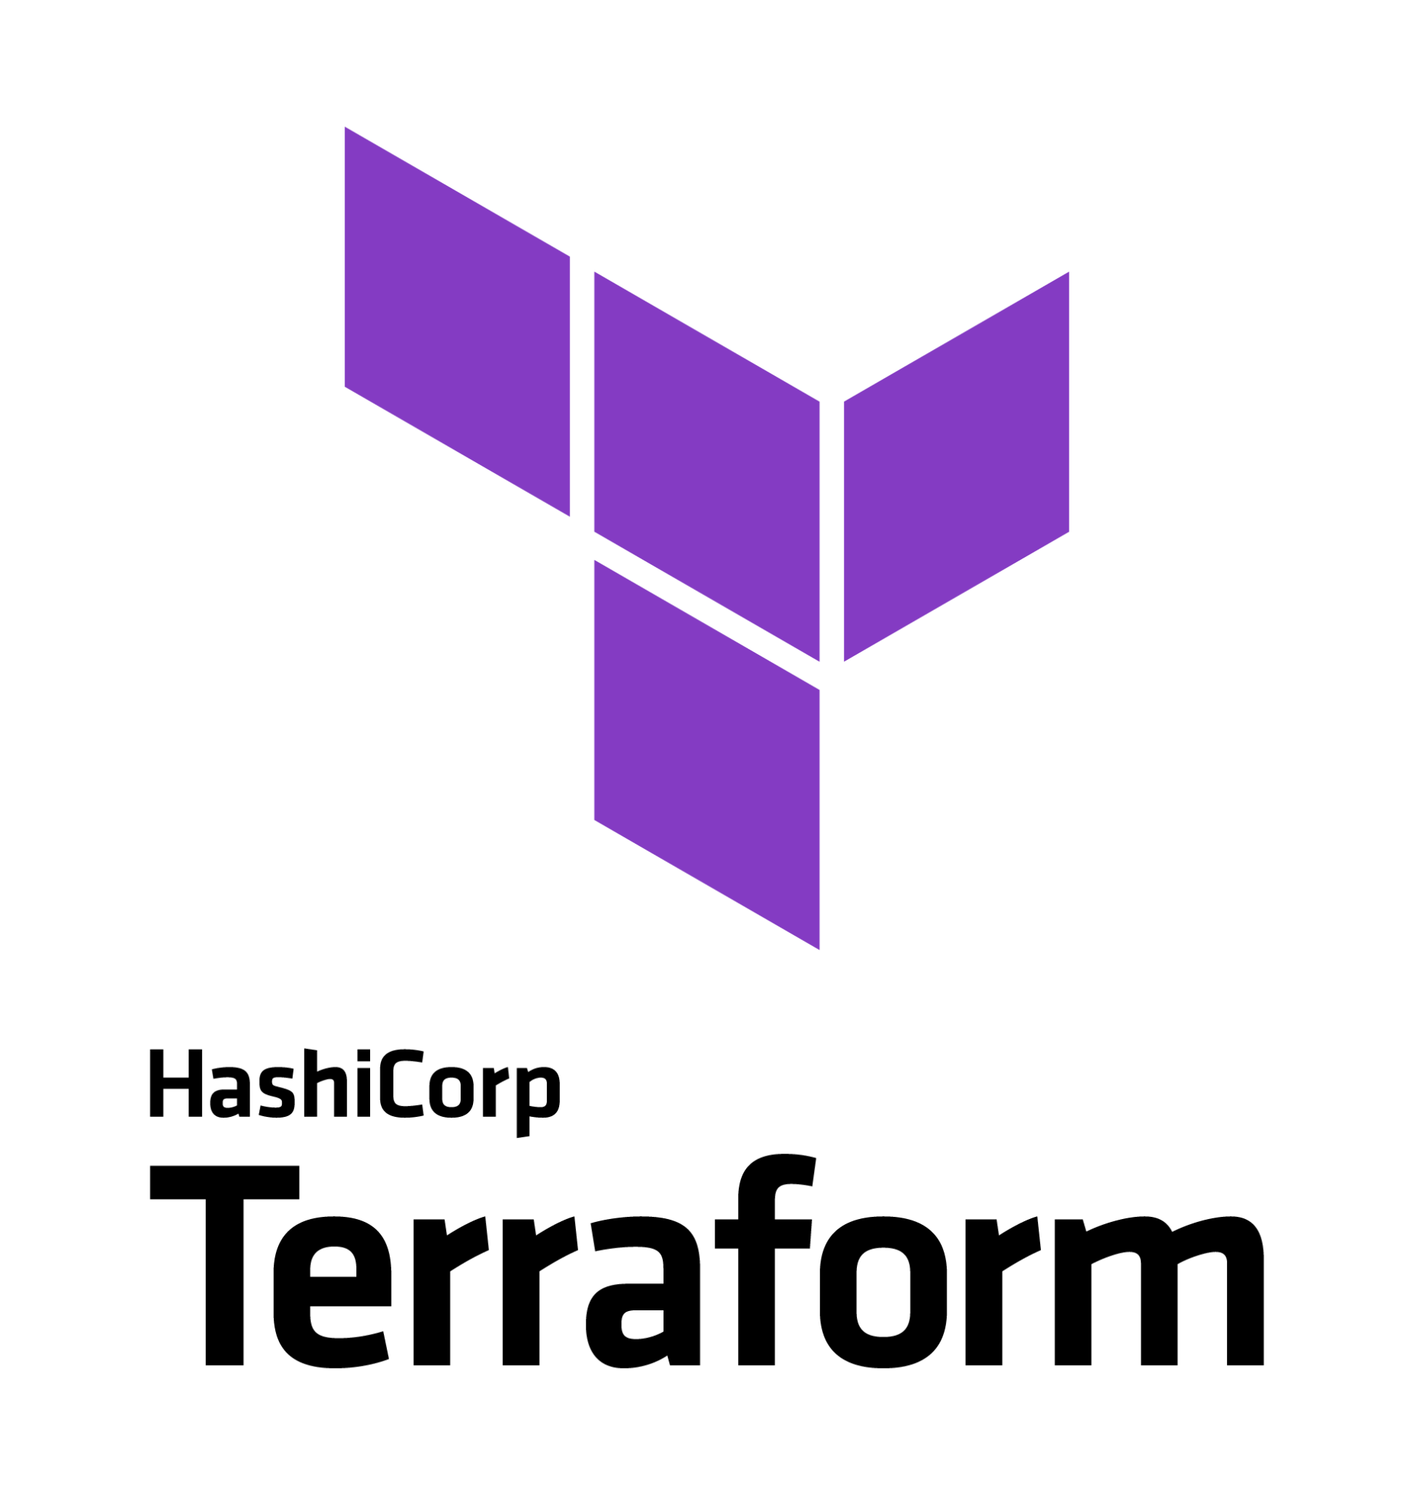

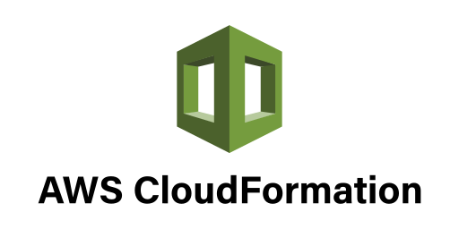

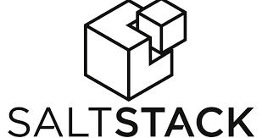
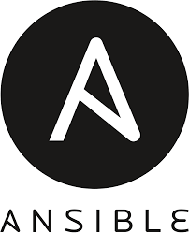
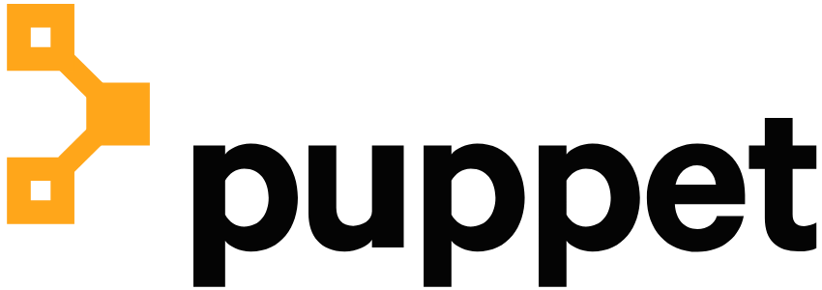
Tools for IaC & Configuration Management

Slide 59
Deployment Automation Techniques & Tools
Notes:
Mandatory
ACTION: Adjust title to fit your course.

Slide 60
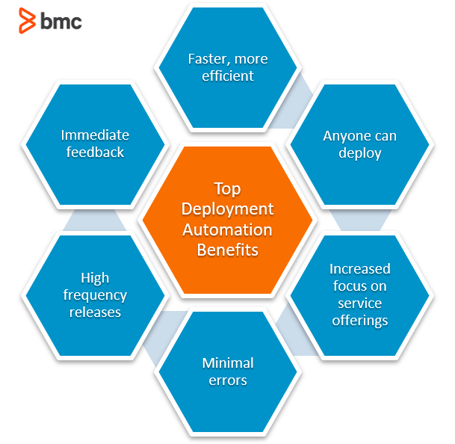
Benefits of Development Automation

Slide 61
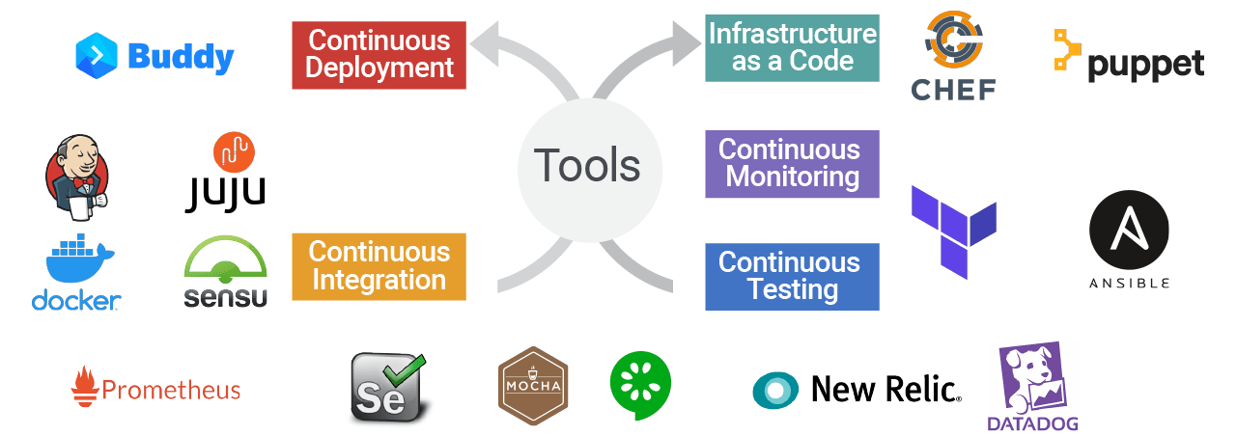
Development Automation Tools

Slide 62
Questions?

